Slide 1


Travel. See the world. Discover your opportunities to go abroad!
PhD Day 2026 Mgr. Kristýna Bajgarová, SCI MU

Slide 2

Your PhD can travel.
A mobility can give you access to new methods, datasets, laboratories or research communities that can shape your PhD.
30+ DAYS
A stay abroad of at least one month is a mandatory part of doctoral study. Plan it as part of your research, not as an extra.
SCI MUNI | PhD Welcome Day 2026

Slide 3
INTERNATIONAL MOBILITY
Why mobility matters
01
Research
Use equipment, methods or expertise that your home group cannot offer.
02
People
Build working relationships with future co-authors and collaborators.
03
Perspective
See how another team frames problems, organises work and communicates results.
04
Career
Show that you can work independently in a new scientific environment.
SCI MUNI | PhD Welcome Day 2026

Slide 4

INTERNATIONAL MOBILITY
Three useful formats
STUDY STAY
Courses or seminars at a partner university. Usually a full semester.
TRAINEESHIP
Research work in a laboratory, institute or other host organisation. Usually 30+ days.
SHORT DOCTORAL MOBILITY
A focused stay of 5–30 days, useful for a method, experiment or intensive collaboration.
SCI MUNI | PhD Welcome Day 2026

Slide 5

INTERNATIONAL MOBILITY
A good host fits the project
METHOD
What do they do that your team cannot?
PERSON
Who would supervise or collaborate with you?
OUTPUT
What should exist at the end: data, protocol, paper, skill?
TIMING
When does the visit fit your experiments and milestones?
Your supervisor’s network is often the fastest starting point.
SCI MUNI | PhD Welcome Day 2026

Slide 6

INTERNATIONAL MOBILITY
Funding routes
ERASMUS+
Study stays, traineeships and short doctoral mobility.
FACULTY SUPPORT
Faculty scholarship A.6
FREEMOVER
A possible route when no standard partnership fits the plan.
EXTERNAL CALLS
DAAD, AKTION, Barrande, CEEPUS, SEMP, AIA, Fulbright, discipline-specific schemes, grant funding …
Deadlines and conditions change. Check the current call before you plan around a grant.
SCI MUNI | PhD Welcome Day 2026

Slide 7
INTERNATIONAL MOBILITY
Where to find reliable information
FACULTY WEBSITE
Mobility options, faculty calls and contacts
MU CENTRE FOR INTERNATIONAL COOPERATION
Erasmus+ rules, applications and university-wide guidance
ACADEMIC INFORMATION AGENCY
Country offers and external scholarship calls
PhD NEWSLETTER for EARLY STAGE RESEARCHERS
New calls, events and opportunities sent to your inbox
YOUR COORDINATORS
Your supervisor, department coordinators and SCI MU International Relations Office
SCI MUNI | PhD Welcome Day 2026

Slide 8
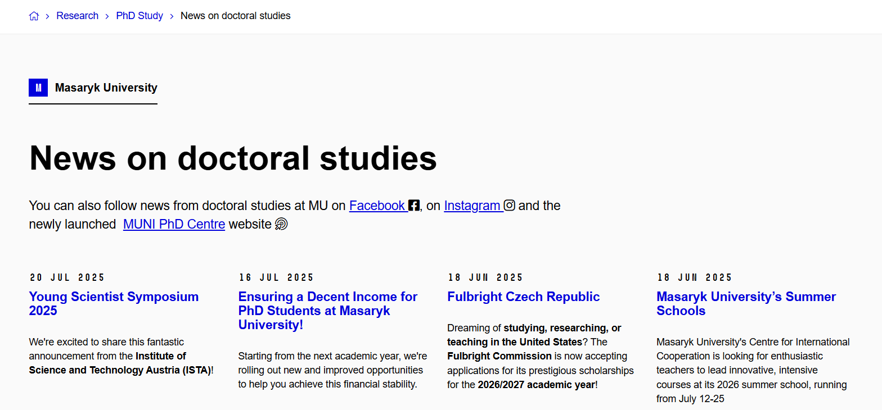
MU Portal
SCI MUNI | PhD Welcome Day 2026

Slide 9
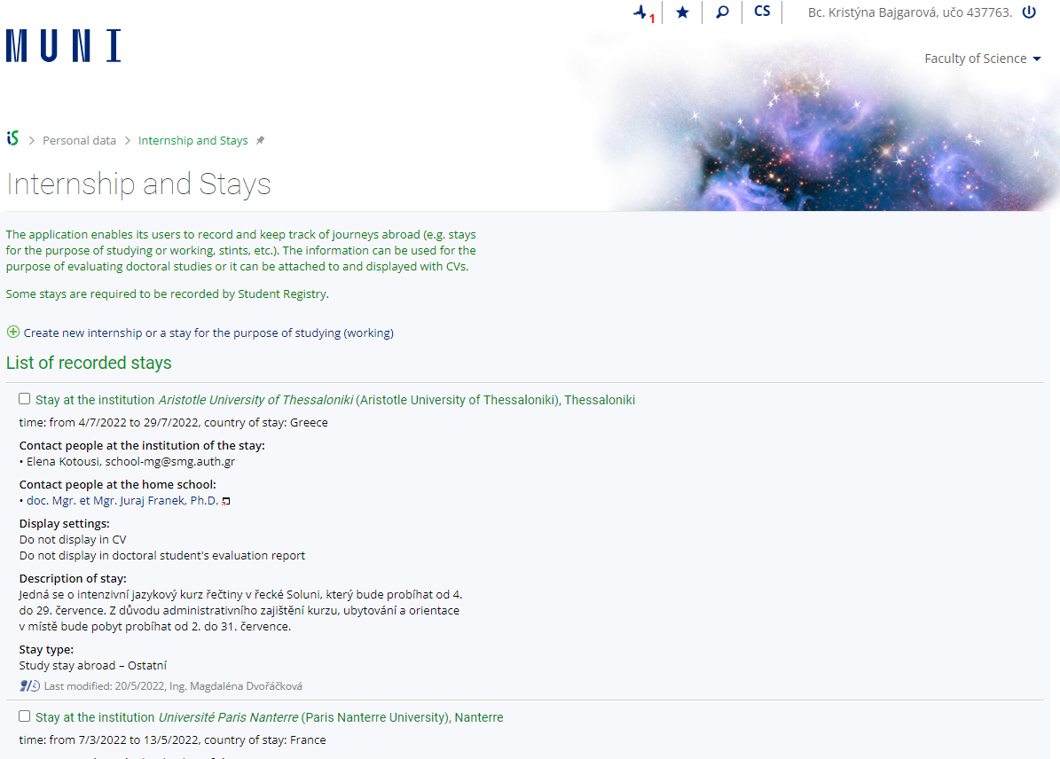
INTERNATIONAL MOBILITY
Recognition and evidence
BEFORE
Check what documents you will need – typically, Learning Agreement for Traineeships. Create the mobility record in IS MU.
DURING
Ask the host institution to sign your Traineeship Certificate before you leave.
AFTER
Upload the Traineeship Certificate to the mobility record and submit the application for recognition.
Recognition is mandatory. Without it, the stay does not count towards the mobility requiremen
SCI MUNI | PhD Welcome Day 2026

Slide 10
Your first three steps
You do not need a complete plan before you start the conversation.
1
Talk to your supervisor
possible hosts, timing and expected output
2
Explore funding
choose the route before completing forms
3
Contact the host
confirm interest and workable dates
Do not wait too long, start planning during your 1st year!
It is also part of your individual study plan!
SCI MUNI | PhD Welcome Day 2026

Slide 11
Planning
Start a few months before the intended departure.
5–6 MONTHS
Discuss the scientific purpose, host and timing with your supervisor.
3–4 MONTHS
Choose the funding route, check deadlines to complete applications.
FEW WEEKS BEFORE
Complete paperwork, approvals, insurance and travel arrangements.
BEFORE LEAVING
Make sure you have the mandatory document required by MU – typically, LA for Traineeships.
SCI MUNI | PhD Welcome Day 2026

Slide 12
IMPORTANT
40
Do you have an
employment contract
with Faculty of Science or CEITEC*?
DAYS
Contact the responsible person at your department or institute at least 40 days before departure.
This is separate from any scholarship application. You and yourr workplace must arrange the employment formalities. If the deadline is already close, contact them immediately.
* The same principle applies if you work for an employer other than MU: inform your employer about the planned stay.
Do not wait until the scholarship or host confirmation is final. The sooner they know, the easier to plan it will be.

Slide 13
Erasmus+ Short-term for PhD students
5-30 days, better funding
Deadline: 31.05.2027
Erasmus+ internships
At least 60 days, for stays from January 2027
4 deadlines: 31.10.2026, 31.1.2027,…
Freemover
At least 30 days, good option for 5-6 weeks long stays
Deadline: 15.12.2026
(1 deadline/year)
Stays in academic year 2027/2028
Priority given to Bc and Mgr students!
Anywhere in the world!
Current MU calls:
Faculty scholarship A.6.
30+ day stay in 2026
One-time call for conference support
Deadline 15.10.2026
Only for events in 2026
New call for 2027 probably next year
If needed, 14-days stays
New call in January 2027

Slide 14
Our Contact
International Relations
A: Kotlářská 2, building 1, room 01006
Common email: int@sci.muni.cz
Kristýna Bajgarová: bajgarova@sci.muni.cz
We're here to address your questions and help you.
You do not need to plan your mobility right now. Just remember where to find us when you are ready.

Slide 15

Questions?
What research need or skill could a stay abroad help you solve?
Which institution, research group or person would be a useful host for you?
What is your biggest practical concern?
YOU‘VE GOT THIS!

