Slide 1
Networking and opportunities for PhD students
Maja Klimentic and Hana Selicova

Slide 2
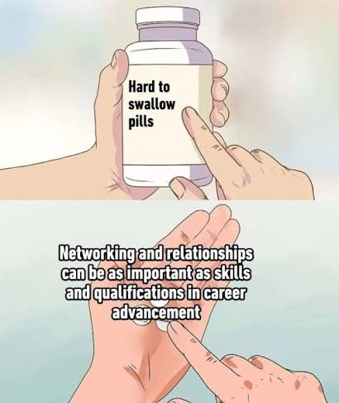
are

Slide 3

You miss 100% of shots you don’t take
“Can I join you?”
Office, cohort, peers
Field-specific activities
Send that email
Take up space
You lose nothing

Slide 4
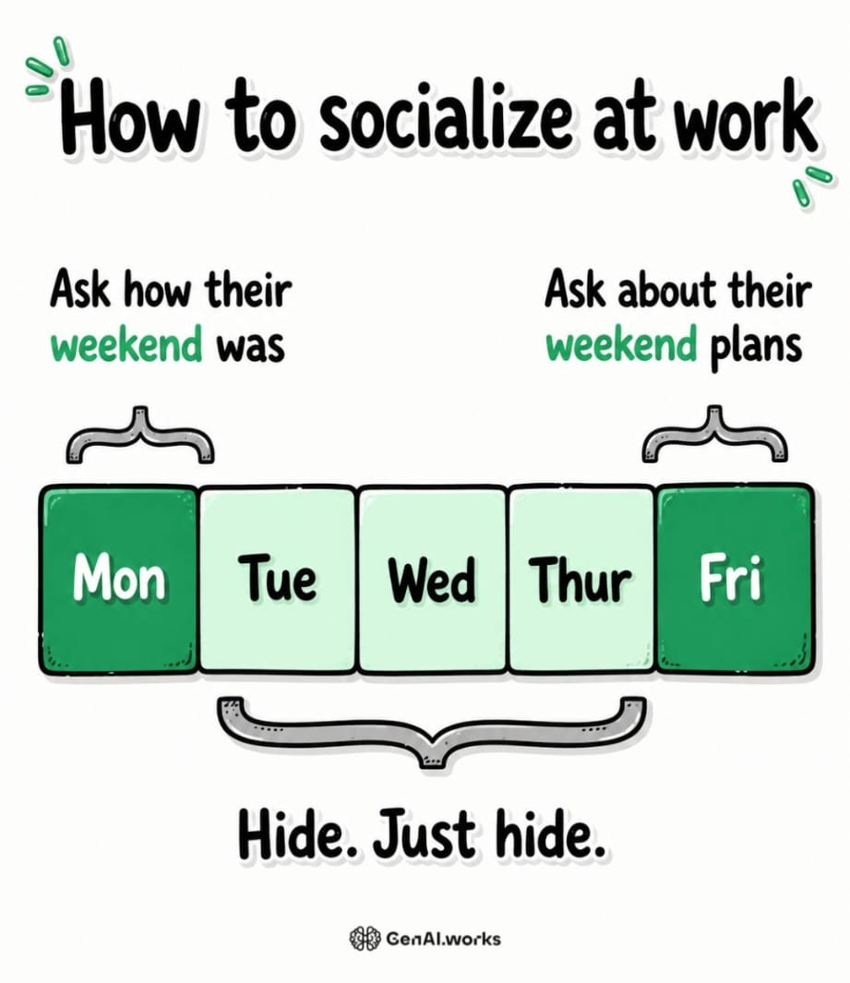
Tips for networking
Care, actively listen, and ask questions
Have a goal
Join the youth branches of societies
You are more than the science you do, and so is your conversation partner
Follow-up
Be realistic: you won’t click with everyone, and you don’t have to.

Slide 5
Soft skills matter
And they can always be improved
MMD
Teaching assistance and science popularisation events
CERPEK MUNI
SciComms – new course
Books/content

Slide 6

Yipee! You are already networking!
and have few new contacts :)

Slide 7

Opportunities in smaller grants and fundings
Winning travel grant = lower price for the group = better chance for you to actually travel for work
Don’t rely only on your supervisor to find opportunities
Snowball effect
Increases your writing and applying skills

Slide 8
What are the possibilities?
Student travel grants
Youth travel grants (can be separated from student awards)
Stipends for travels from bigger companies
  Shimadzu stipend at Chromatography conference
Summer schools – some fully granted
  ERASMUS participants like Debunker
Out of traveling awards for funding part of your research (EDUC Mini-project)
Big funds like MSCA Doctoral Networks and PhD Talent (23.09 DL)

Slide 9

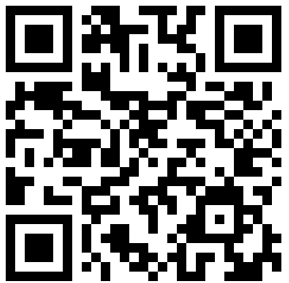
Where to search?
Newsletters (all wave at Linda now!)
  Very useful information, opportunities and calls for students in here, READ IT!
Websites of the conferences and summer schools you are interested in
  Bursaries, travel awards, young investigators awards
Websites of societies of your topic
IS Noticeboard
  https://is.muni.cz/auth/noticeboard/?lang=en;setlang=en
Companies websites – can offer some part of the stipend for use of a specific product / brand
University websites
  MU Young Researchers Grant?
  Competities and awards MU → QR code
Notes:
Soutěže a ceny | Přírodovědecká fakulta MU | MUNI SCI – Hana add QR code

Slide 10

Upcoming networking opportunities
PhD Centre | MUNI
PhD days RMU 9. – 13.11.2026
Dean’s BBQ
Night of Science

