Slide 1

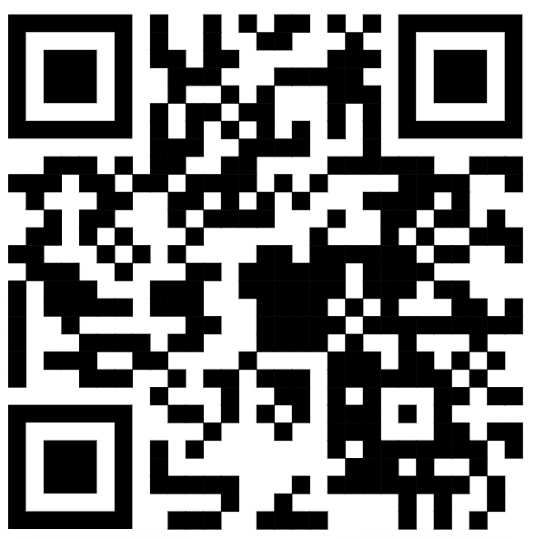
https://mmd.muni.cz/
PhD Day 2026
Jan Paleček, vice-dean for PhD, SCI MUNI

Slide 2
Intro
HR Excellence in research award
What is your PhD about?
Why MMD …

Slide 3
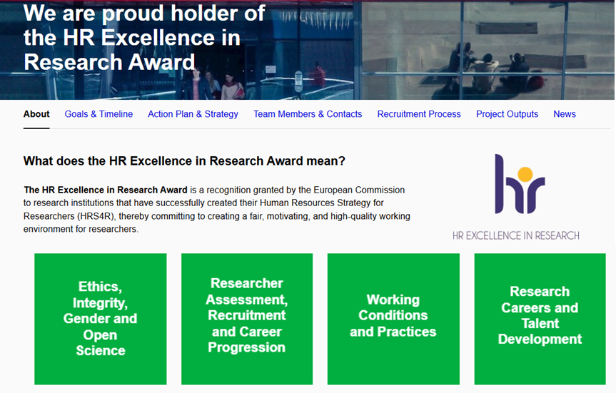
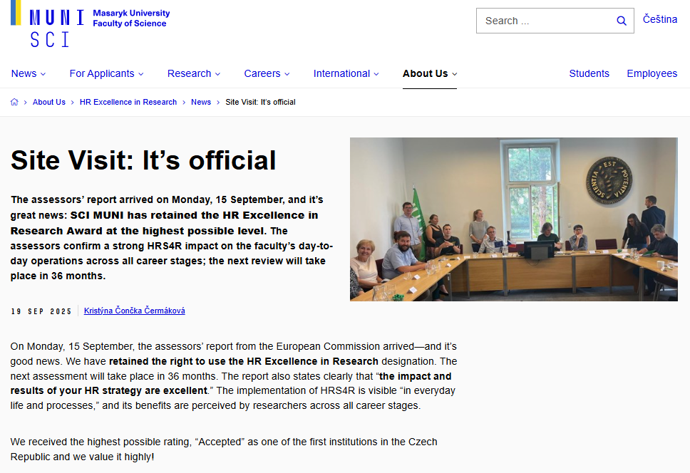
HR Award at SCI MUNI – HR Excellence in Research, HRS4R
HR Excellence in Research Award is an award by European Commission granted to institutions that implement the new HR (Human Resources) Strategy for Researchers (HRS4R).
SCI MUNI gained it in 2018 and has renewed it in September 2025
https://www.sci.muni.cz/en/about-us/hr-excellence-in-research

Slide 4
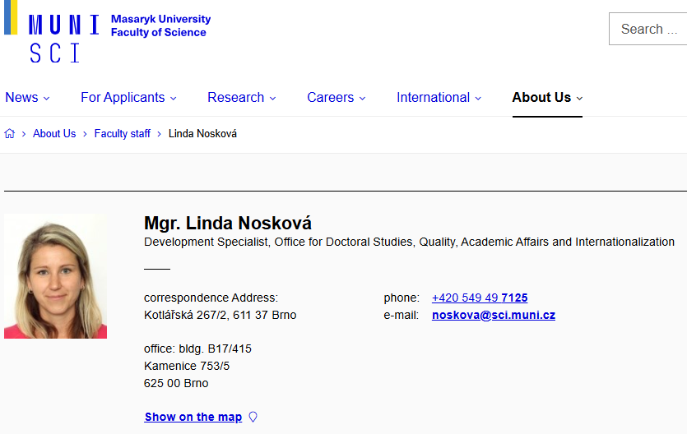
HR Award at SCI MUNI – HR Excellence in Research, HRS4R
The HRS4R implementation includes the Early-stage Researchers development and mentoring concept at SCI MUNI: Development Strategy, PostDoc web, PhD web, trainings, support provided by our Development Specialist for Early-stage Researchers.
HR Excellence in Research Award is linked to the new European Competence Framework for Researchers. Check competencies crucial for your research career!
Give us your feedback
Share with us your views - questionnaire will be distributed after the PhD Day.
Your opinions expressed in Questionnaire Surveys in previous years you can find here

Slide 5
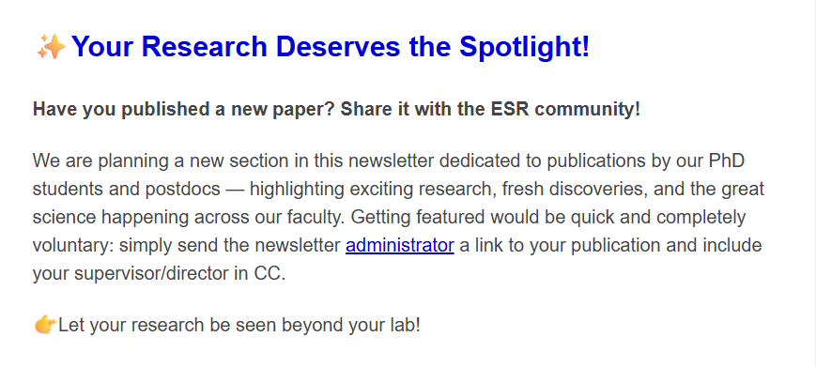
Newsletter for PhD students

Slide 6

Improving quality of PhD training at MUNI and aligning with international standards
Science 1st!

Slide 7
Improving quality of PhD training at MUNI and aligning with international standards
Science 1st!
Preparation for following career
  Independence and responsibility building
  Duration (4 years) corresponding to career planning
  Interdisciplinary & Intersectorial experiences
  Transferable and soft skills

Slide 8
Improving quality of PhD training at MUNI and aligning with international standards
Science 1st!
Preparation for following career
  Independence and responsibility building
  Duration (4 years) corresponding to career planning
  Interdisciplinary & Intersectorial experiences
  Transferable and soft skills
International (global) network & mobility

Slide 9
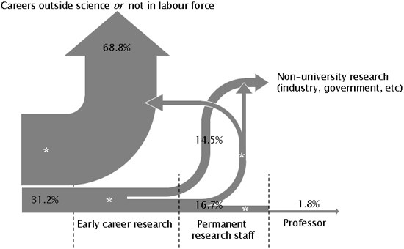


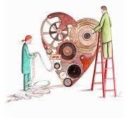
Ready for Science? … for Research? … for PhD?
Love and passion
Determination
& Career planning
Responsibility
Notes:
Love science! Want to advance and contribute!
Many different ways how to be involved … and just one is PhD (others are research technician etc etc)
PhD – independence, desire to work on your own, take responsibility, become leader
Important decision and career step
Demanding task and obligation for 3-4 years and much beyond
Obligation and contract for all parties
Students
Supervisor(s)
Doctoral Boards!

Slide 10

MMD helps
Established 2022 to commemorate
200th birthday of GJM
Science 1st!
Preparation for following career
  Independence and responsibility building
  Duration (4 years) corresponding to career planning
  Interdisciplinary & Intersectorial experiences
  Transferable and soft skills
International (global) network & mobility
Elements and criteria
Be pro-active (student <> supervisor <> Doctoral Board)
Seminars – MMD & beyond
Learn more
Summer schools
Secondments in industry
Communication, leadership
Doctor
Europaeus
3 months abroad
International defence

Slide 11

How MMD works …
XD007 in IS MUNI as a tool
< each semester >
Evaluation of the Application by MMD Committee
Monitoring of participation in centrally offered courses
Enrollment to MMD Programme
[IS MUNI course XD007]
Preparation and uploading of the Application Dossier
`
[
]
3 months
international
secondment
Motivation, interest and support
- Student, Supervisor, PhD Board
Show your activities
E.g. Previous engagement
Deadline: 25 Sept 2026
Results announced
Oct 2026
End of semester:
short report (describe your efforts – also other non-MMD activities)

Slide 12

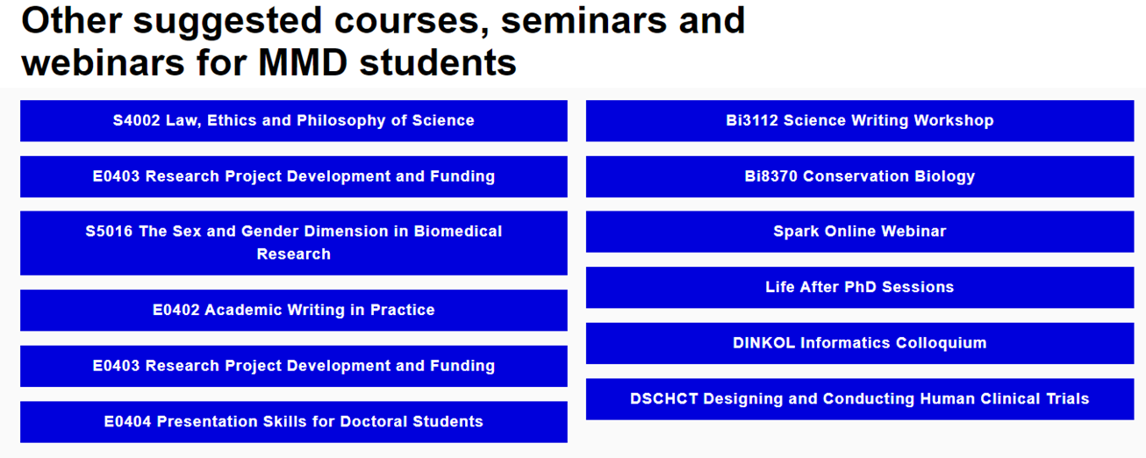
MMD offers interdisciplinary trainings
And/or be active,
join other trainings
(and report your activity at the end of semester)

Slide 13
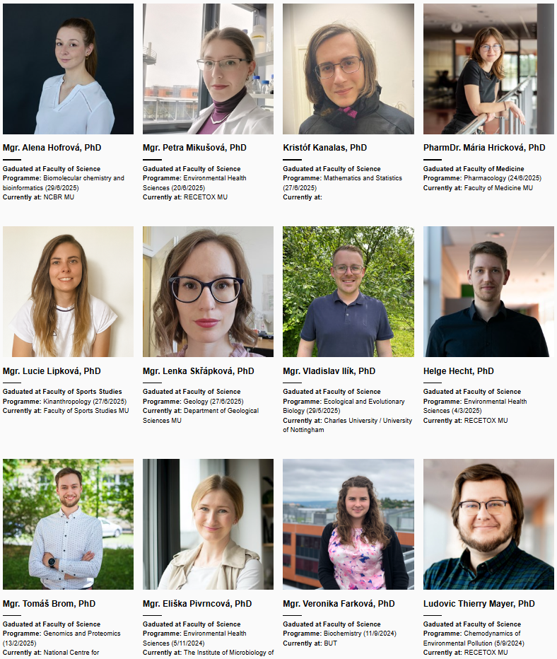
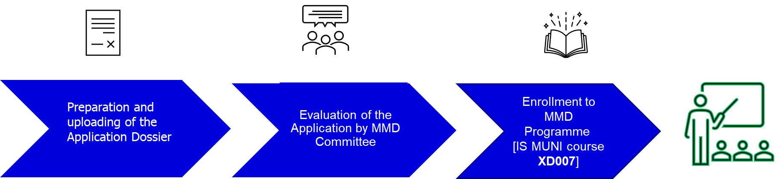



How MMD works …
Finishing and submitting doctoral thesis in English
after 4(+1) years
Oral thesis presentation and defence in European Doctorate format
MMD & European Doctorandus certificates
International
reviewers
& committee
10 000 CZK for succesfull defense

Slide 14
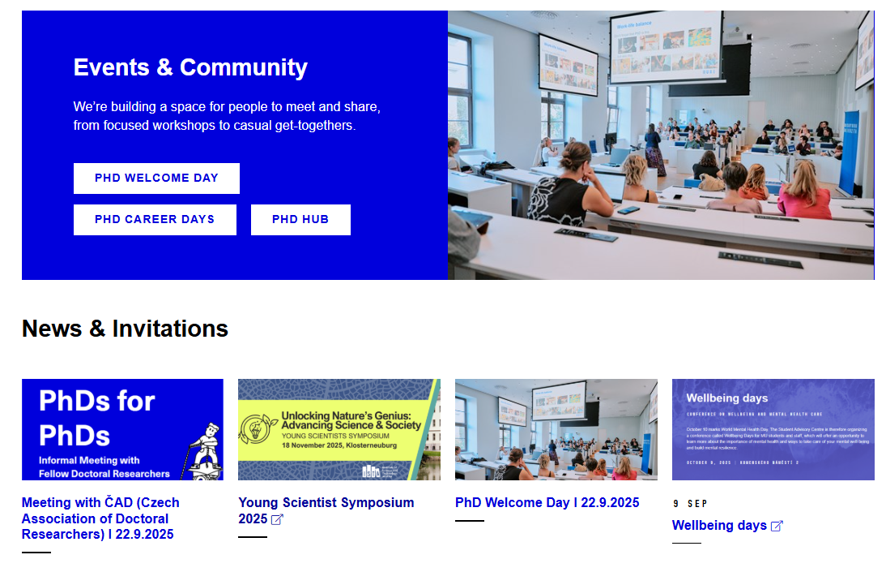
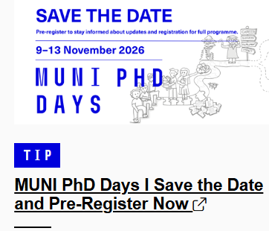

We coordinate with other MUNI support to PhDs …
https://phd.muni.cz/

Slide 15

Ready for Science? … for Research? … for PhD?
Then, you should TRY
Notes:
Contipro – stánek na coffee, career and interdisciplinary experiences…

