Slide 1
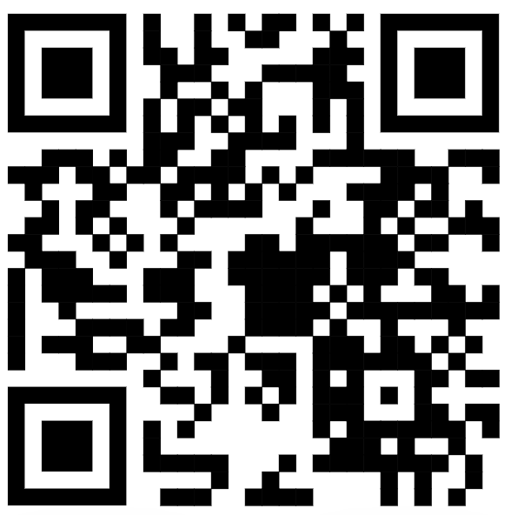
https://mmd.muni.cz/
PhD Day, 6.10.2023
Luděk Bláha, vice-dean for PhD, SCI MUNI

Slide 2
HR Award at SCI MUNI – HR Excellence in Research, HRS4R
Award by European Commission granted to institutions that implement the new HR (people) Strategy for Researchers (HRS4R, HR Logo) – SCI gained in 2018 and has to renew it in 2024.
Commitment to create an open and international working environment and culture, support career development, share information & opportunities, and establish transparent recruitment and onboarding procedures for worldwide researchers including PhD students as a first stage of a research career
Early Stage Researchers development and mentoring concept at SCI MUNI: Development Strategy, PostDoc web, PhD web, trainings, support provided by our Development Specialist for Early Stage Researchers.
Call for help and cooperation
Build new people processess with us at the faculty! Help us to retain the HR logo!
We have to renew the certification in 2024 and your opinions are important
Join our Researcher Focus Group at SCI MUNI: the group is open, everybody is welcome, apply via e-mail HRAward@sci.muni.cz or contact us directly at the HR Award Office
Share with us your views - questionnaire distrbuted after the PhD Day
THANK YOU!

Slide 3
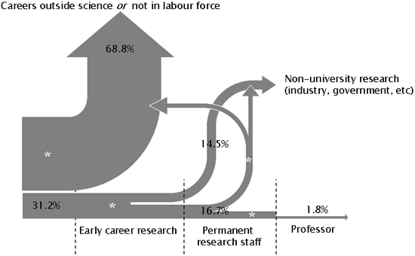
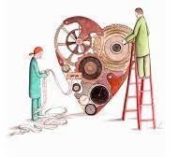
Ready for Science? … for Research? … for PhD?
Love and passion
Determination
& Career planning
Responsibility

Slide 4
Improving quality of PhD training at MUNI and aligning with international standards

Slide 5
Improving quality of PhD training at MUNI and aligning with international standards
Science 1st!

Slide 6
Improving quality of PhD training at MUNI and aligning with international standards
Science 1st!
Preparation for following career
Independence and responsibility building
Duration (3-4 years) corresponding to career planning
Interdisciplinary & Intersectorial experiences
Transferable and soft skills

Slide 7
Improving quality of PhD training at MUNI and aligning with international standards
Science 1st!
Preparation for following career
Independence and responsibility building
Duration (3-4 years) corresponding to career planning
Interdisciplinary & Intersectorial experiences
Transferable and soft skills
International (global) network & mobility

Slide 8
MMD helps
Established 2022 to commemorate 200th birthday of GJM
Science 1st!
Preparation for following career
Independence and responsibility building
Duration (3-4 years) corresponding to career planning
Interdisciplinary & Intersectorial experiences
Transferable and soft skills
International (global) network & mobility
Elements and criteria
Be pro-active (student <> supervisor <> Doctoral Board)
Seminars – MMD & beyond
Learn more
Summer schools
Secondments in industry
Communication, leadership
Doctor Europaeus
3 months abroad
International defence

Slide 9
How MMD works …
XD007 in IS MUNI as a tool
< each semester >
Monitoring of participation in centrally offered courses
Evaluation of the Application by MMD Committee
Enrollment to MMD Programme
[IS MUNI course XD007]
Preparation and uploading of the Application Dossier
[
]
3 months
international
secondment
Motivation, interest and support
- Student, Supervisor, PhD Board
Show your activities
E.g. Previous engagement
Deadline: 15.10.2023
Results announced
October 18, 2023
End of semester:
short report (describe e.g. other non-MMD activities)

Slide 10
MMD offers interdisciplinary trainings
And/or be active,
join other trainings
(and report your activity at the end of semester)

Slide 11
MMD offers interdisciplinary trainings
And/or be active,
join other trainings
(and report your activity at the end of semester)

Slide 12
How MMD works …
The 1st MMD graduates - 2022-2023
Martin Toul
> VIB Ghent, BE
Libor Šulc
> Karolinska, SE
Tomáš Janoš
> IS Global, ESP
Finishing and submitting doctoral thesis in English after 4(+1) years
Oral thesis presentation and defence in European Doctorate format
MMD & European Doctorandus certificates
International
reviewers
& committee

Slide 13
Ready for Science? … for Research? … for PhD?
Then, you should TRY
Notes:
Contipro – stánek na coffee, career and interdisciplinary experiences…

