Slide 1
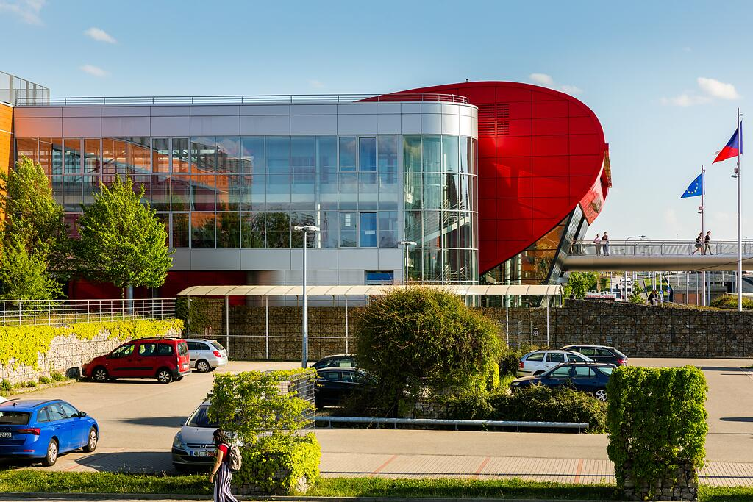
PhD Day
RMU Research Office: Lukáš Palko, Ivana Jašková, Markéta Burešová
6 October 2023

Slide 2
Research Office

Slide 3
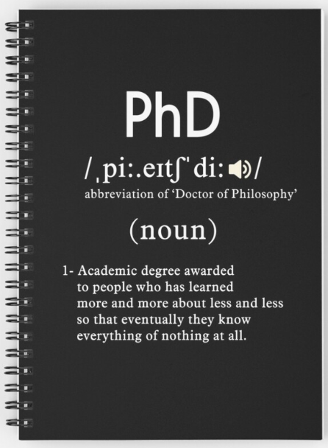
Ph.D.

Slide 4
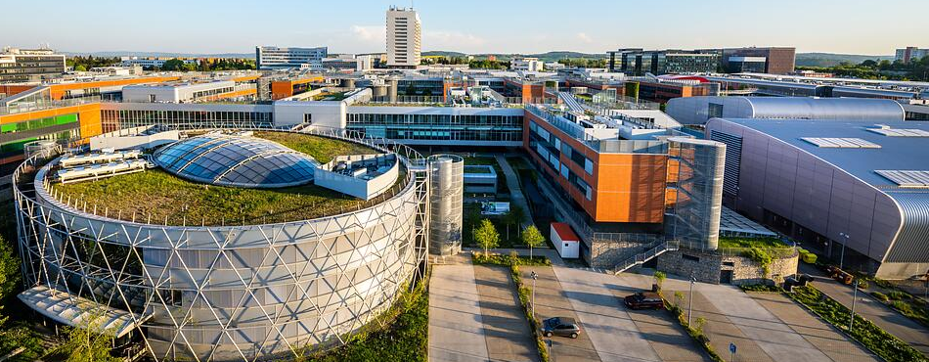
MUNI ?
MUNI is the best research institution in EU13 (Central & Eastern Europe)
..in terms of grant funding form EU (Horizon Europe)

Slide 5
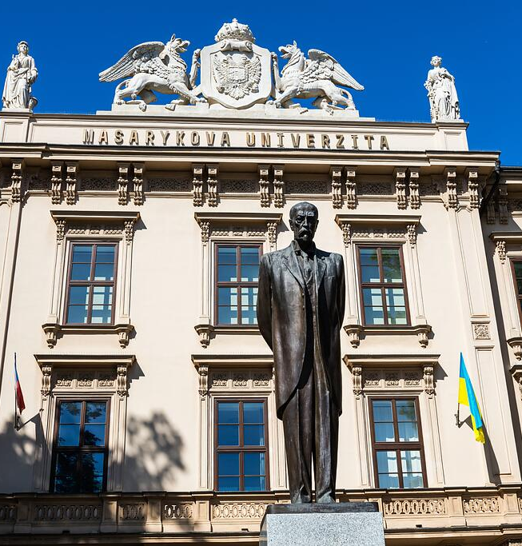
MUNI in Numbers
MUNI
10 faculties
Law, Medicine, Science, Arts, Education, Pharmacy, Economics and Administration, Informatics, Social Studies, Sports Studies
33.500 students in all levels of study
PhD Studies
2.500 PhD candidates (not students)
30% foreigners 54 % women, 43,6 % men, 2,4 % not mentioned 65 % at age under 29

Slide 6
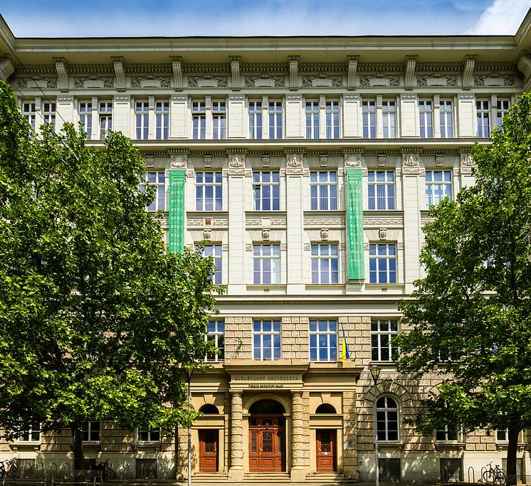
Welcome to MUNI
We are MUNI
You are welcomed
We all are MUNI (including you)
This is the PhD day

Slide 7
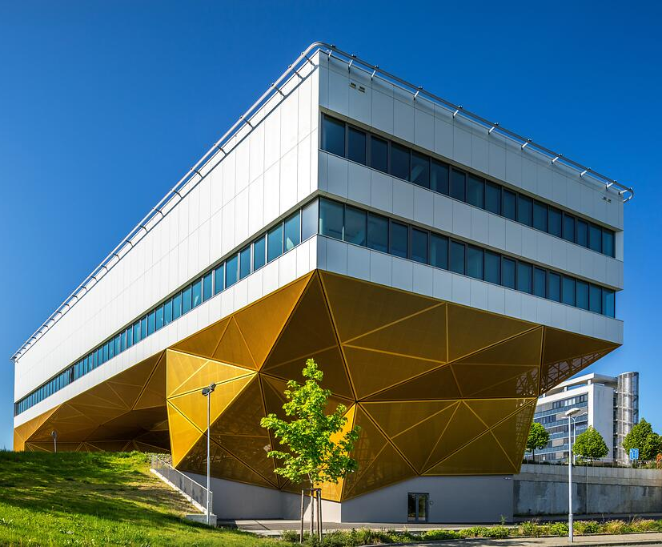
Briefly on PhD Studies at MUNI
4 years standard duration of studies
can be extended
136 PhD programmes with active students
74 in English
Scholarship for fulltime students
during their first 4 years of study
€ 630 from September 2023
Highly modern facilities and laboratories
Open Access research capacities

Slide 8
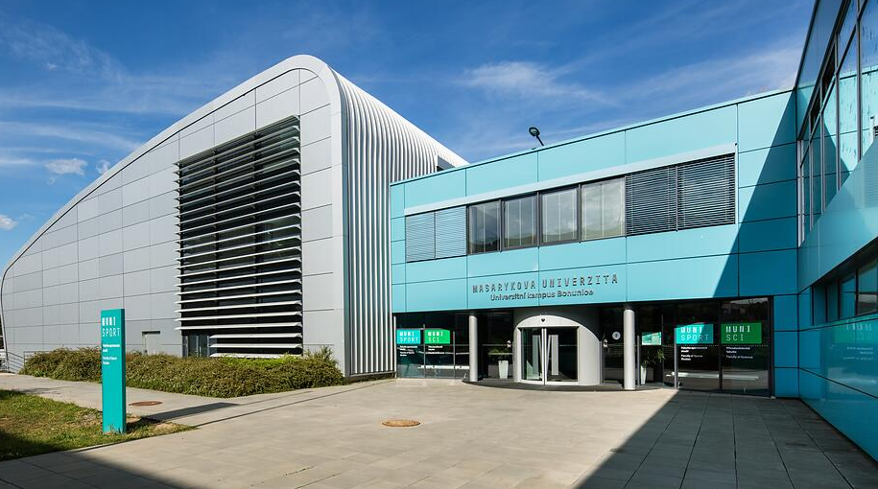
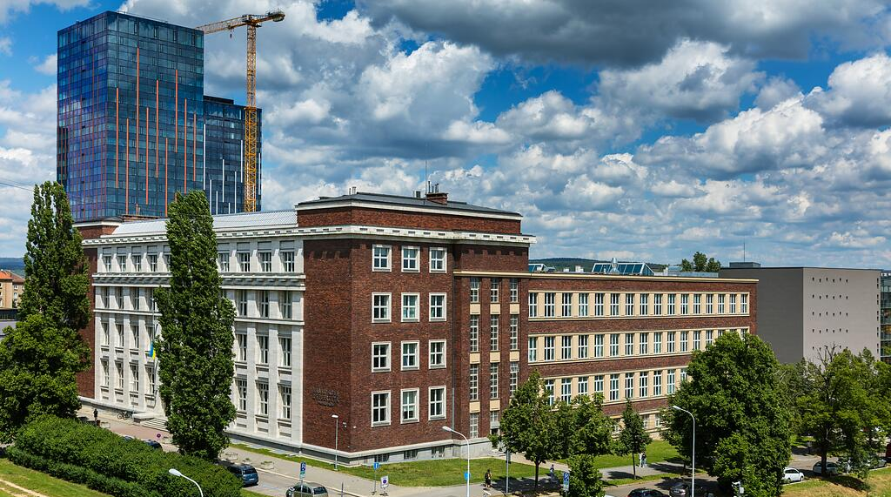
MUNI PhD Study Info - www.portal.muni.cz
PhD guide
Videopresentations and ppt presentations
Extract from the MU study & examination regulations
Individual study plan in the IS MU
Principles and recommendations for doctoral studies
Info on important study regulations
Diplomas and graduation ceremony

Slide 9
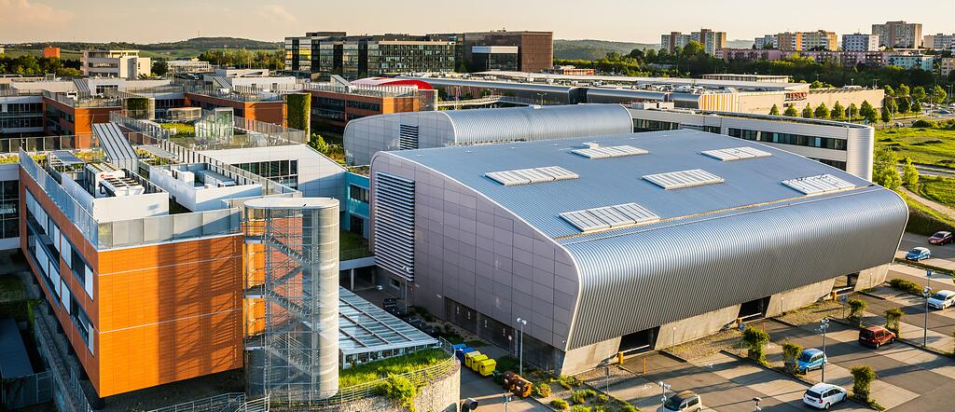
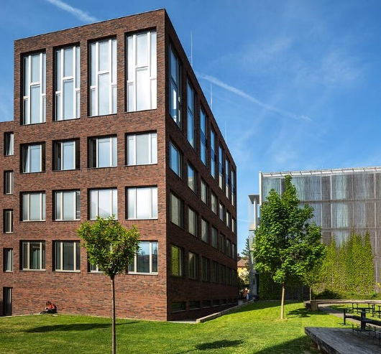
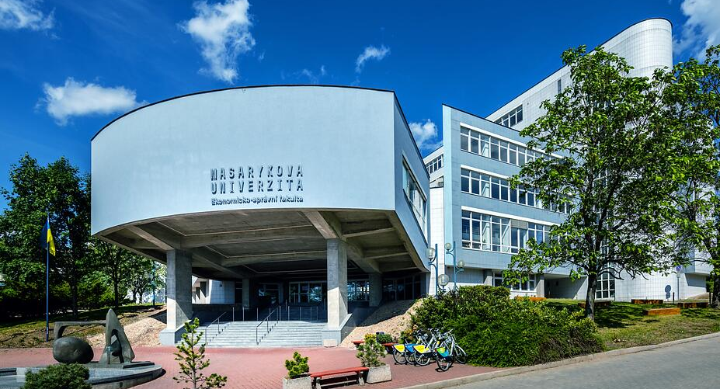
MUNI PHD ACADEMIA
A platform for education, development and support of PhD students and supervisors at MUNI
FRESHERS: Skills for Research Careers – semestral course on researcher career skills
PhD summer school on pedagogical skills
MUNI PhD Career Days (not only) for PhD graduates
Workshops and lectures on soft and transferrable skills, and on highly specialized topics
Lectures, workshops etc. for supervisors

Slide 10
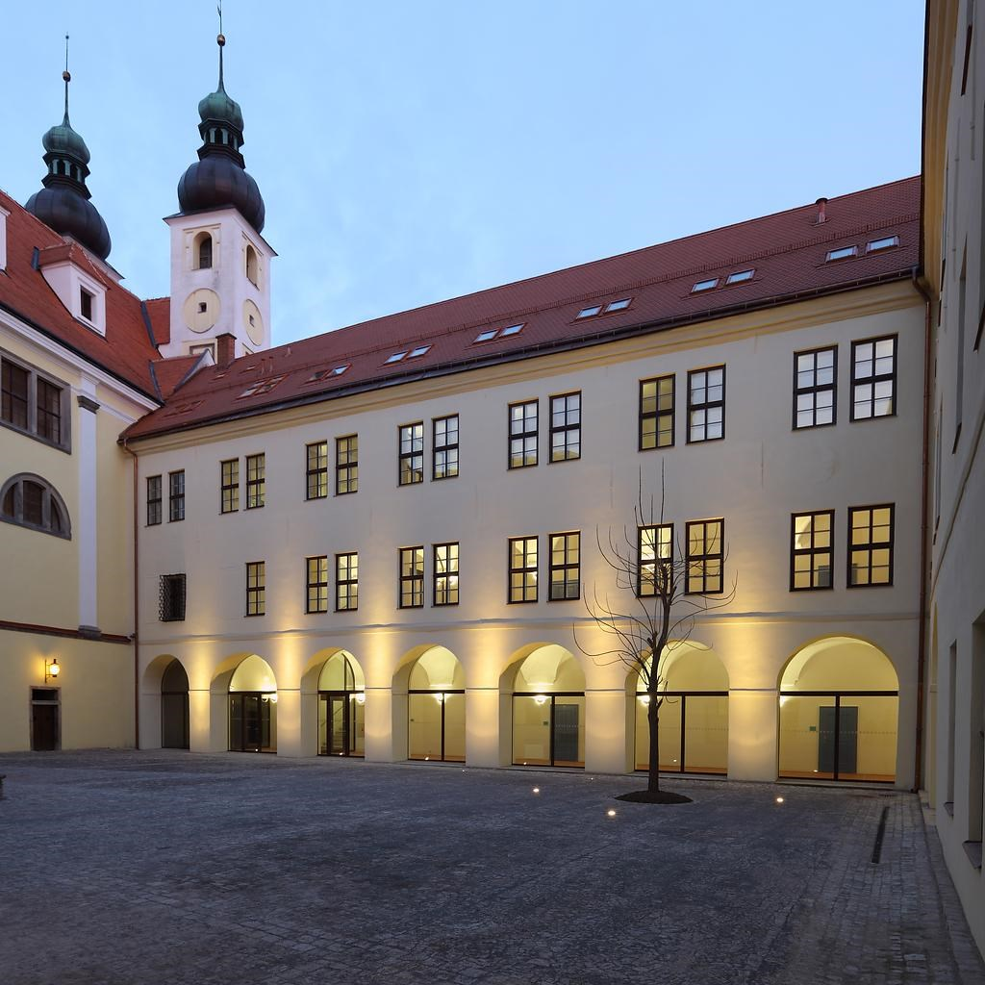
Save the date for this semester
FRESHERS: Skills for Research Careers
Registration
MUNI PhD Career Days
22-23 November 2023
Popularizing science and research communication for PhD students
Effective stress management
3 November 2023 (Czech only)
Master Brain
6 December 2023 (in English)
Seminar Series

Slide 11
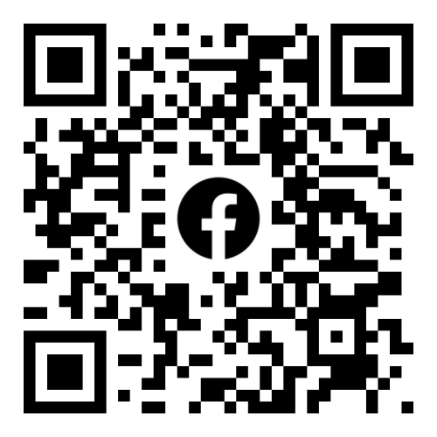
Follow us….
Faculty officers
emails, web, newsletters, FB, ...
MUNI Portal
FB group: MUNI PhDs
X: @MUNI_Science
Web – coming soon… ☺

Slide 12
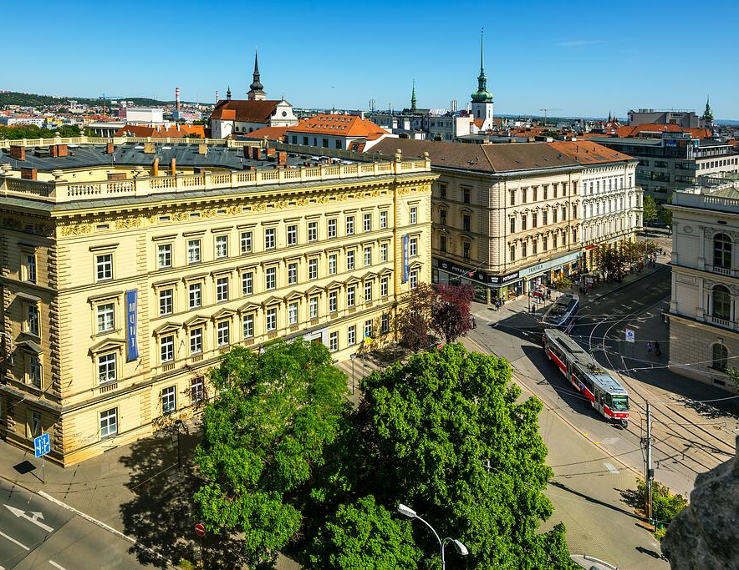
Thank you for your attention!
RMU Research Office Žerotínovo nám. 9 601 77 Brno
Lukáš Palko E: palko@rect.muni.cz T: +420 549 49 5541
Ivana Jašková E: jaskova@rect.muni.cz T: +420 549 49 5541
Markéta Burešová E: buresova@rect.muni.cz T: +420 777 933 767

Slide 13
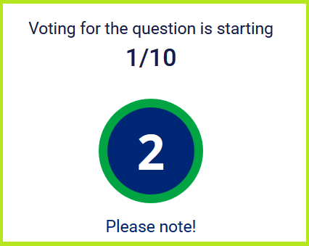
Stay till the end…
…after the „PhD questions and answers" section we invite you to
quiz in KvIS with a chance to win!

